Slide 1
INFO 250 Information Visualization
Week 2A: Task by Data Type Taxonomy
Scales of Measurement
Patterns

Slide 2
Summary of last week
We talked about definition and some other basic concepts about information visualization.
What is information visualization?
What makes a good visualization?
We saw some fancy visualizations, but you should also learn from bad or very simple examples. (An example: https://www.economist.com/graphic-detail/2019/09/24/americas-economics-profession-still-has-a-problem-with-diversity /)

Slide 3
Project of this week
This is an individual project. Complete it independently.
What is the purpose of this assignment?
This assignment is to get you started with some basic but typical information visualization tasks.
In this project, you will use RAWGraphs, a web-based interactive data visualization tool, to get familiar with a few common types of visualizations for tabular data, hierarchical data, and text.
RAW provides a few example sets of data. You can use these sample data to generate visualizations that you think will best communicate the value of a given data set.
RAWGraphs:
https://www.rawgraphs.io/
What are the specific tasks?
Explore the data set with RAW: pick ONE sample data set that you'd like to work with (e.g., the happiness index).
Choose one data set from the "Try our data samples" tab. For your chosen data set, generate and document FOUR types of visualizations with RAW. For your selected data set, you may choose the same set of variables or different sets of variables for the four visualizations. (3 points)
For each visualization, analyze and discuss what it is telling us: (1) how many visual patterns (e.g., contrast, relationship, trend, categorization, saliency) it shows; (2) what are the strengths and weaknesses of each visualization? (5 points)
For this data set, recommend the best visualization option(s) based on your findings in step #2. Justify your recommendation with what we have discussed in this course or your personal insights into visualization. (2 points)
What should be submitted?
A written report that summarizes what you accomplished and provide screenshots of visualizations with brief explanations of your observations.
What are the grading criteria for this?
Completeness, insightful observations, clarity of writing.

Slide 4
A Task by Data Type Taxonomy Shneiderman (1996): The Eyes Have it: A Task by Data Type Taxonomy for Information Visualizations. https://ieeexplore.ieee.org/document/545307
Tasks
Data Type
Overview
Zoom (items of interest)
Filter (retain interested items)
Details-on-demand
Relate (relationships)
History (undo, replay, adjust)
Extract (sample a subset)
One-dimensional: sequential
Two-dimensional: map
Three-dimensional: DNA
Temporal: history
Multi-dimensional
Tree/Hierarchical
Network

Slide 5
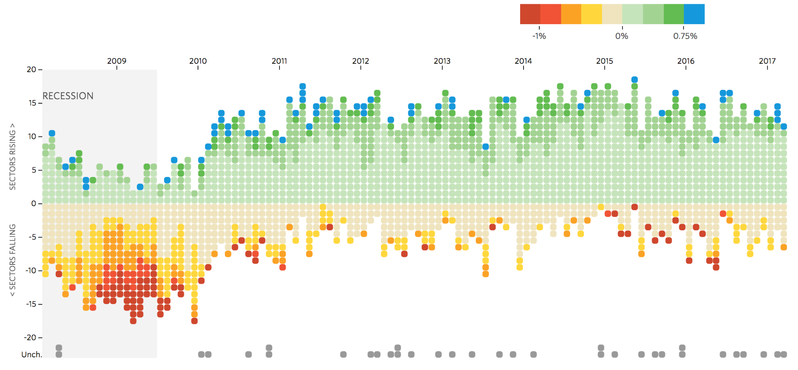
Track National Unemployment, Job Gains and Job Losses
Sectors (boxes) gaining or losing jobs (% change) from previous month in each sector’s payrolls.
http://graphics.wsj.com/job-market-tracker/

Slide 6
Scales of Measurement https://en.wikipedia.org/wiki/Level_of_measurement
Psychologist Stanley Smith Stevens developed the best-known classification with four levels, or scales, of measurement in 1946:
Qualitative:
Nominal
Quantitative:
Ordinal
Interval
Ratio

Slide 7
Incremental progress | Measure property | Mathematical operators | Advanced operations | Central tendency | Variability
Nominal | Classification, membership | =, ≠ | Grouping | Mode | Qualitative variation
Ordinal | Comparison, level | >, < | Sorting | Median | Range, interquartile range
Interval | Difference, affinity | +, − | Comparison to a standard | Arithmetic mean | Deviation
Ratio | Magnitude, amount | ×, / | Ratio | Geometric mean, harmonic mean | Coefficient of variation, studentized range

Slide 8
Examples
Nominal: numbers to identify entities
Examples: zip code: 19104; phone number: 215 895 2000
Ordinal: data can be categorized and ranked, i.e., categories with a natural rank order (distance between them is unknown)
Examples: 1st, 2nd, 3rd
Interval: categorized, ranked, and evenly spaced
Examples: temperature, -10, 0, 10
Ratio: continuous, equal distance between adjacent values, and a true zero (never goes below zero)
Examples: age, weight and height. No such thing as a negative weight

Slide 9
How are variables visually represented
X-axis: months of year (Datetime)
Y-axis: Rising or falling or unchanged (Categorical)
Color: Percentage change from previous month (Categorical) *
Order of the y-axis: The order based on the amount of change of a market in a given month (Ordinal)
(Invisible or not from the data depending on the algorithm): The amount of change of a market in a given month (Ratio)

Slide 10
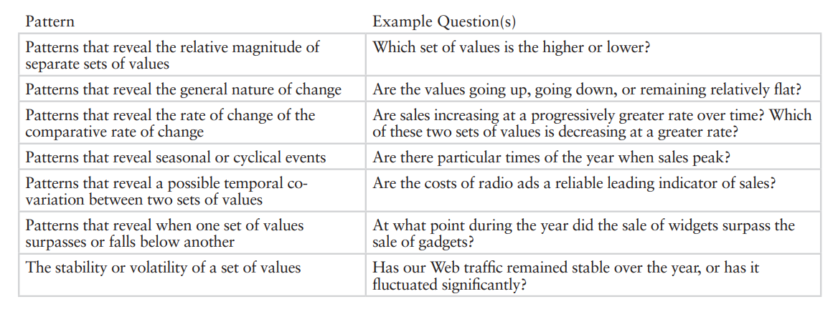
Patterns
Patterns are simply a repetition of more than one design element working in concert with each other. A seamless pattern is one where every element within a design (no matter how often it's repeated) combines to form a whole.
https://www.perceptualedge.com/articles/Whitepapers/Visual_Pattern_Rec.pdf

Slide 11
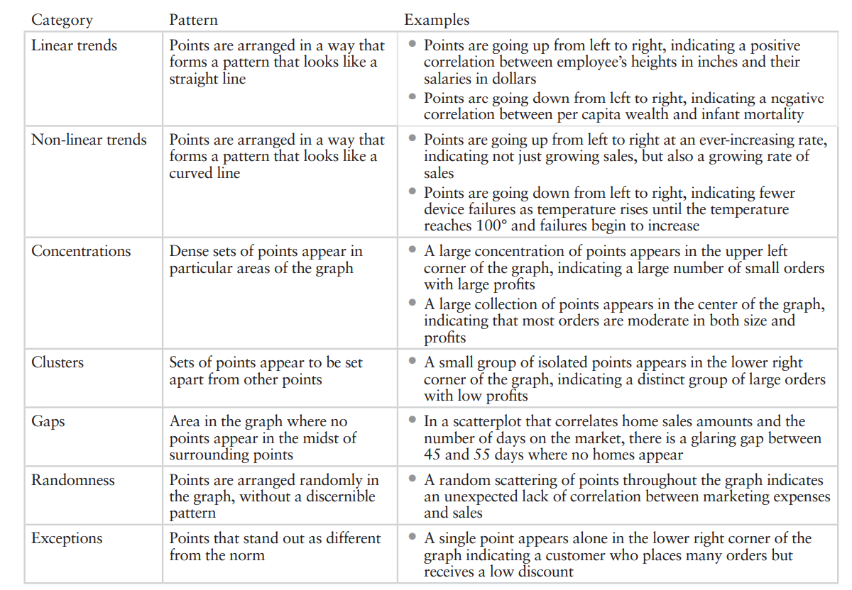

Slide 12
